Slide 1


Slide 2
Designing algorithms

Slide 3
For insertion sort, we used an incremental approach: having sorted the sub-array A[1…. j -1], we inserted the single element A[j] into its proper place, yielding the sorted sub-array A[1……j] .
we examine an alternative design approach, known as “divide and conquer,”. We’ll use divide and conquer to design a sorting algorithm whose worst-case running time is much less than that of insertion sort.

Slide 4
The divide-and-conquer approach
The divide-and-conquer paradigm involves three steps at each level of the recursion:
Divide the problem into a number of sub problems that are smaller instances of the same problem.
Conquer the sub problems by solving them recursively. If the sub problem sizes are small enough, however, just solve the sub problems in a straightforward manner.
Combine the solutions to the sub problems into the solution for the original problem.

Slide 5
The merge sort algorithm closely follows the divide-and-conquer paradigm. Intuitively, it operates as follows.
Divide: Divide the n-element sequence to be sorted into two subsequences of n=2 elements each.
Conquer: Sort the two subsequences recursively using merge sort.
Combine: Merge the two sorted subsequences to produce the sorted answer

Slide 6
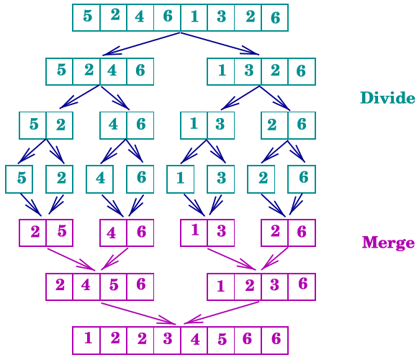
Merge Sort: Illustration

Slide 7
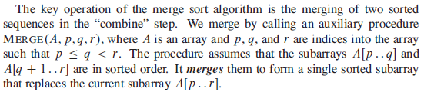

Slide 8
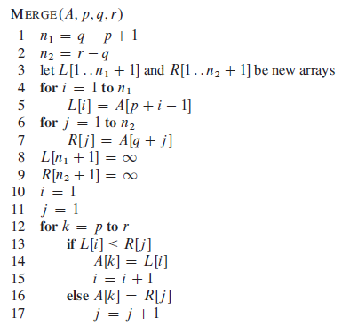

Slide 9
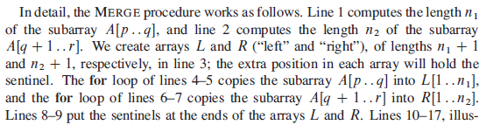


Slide 10
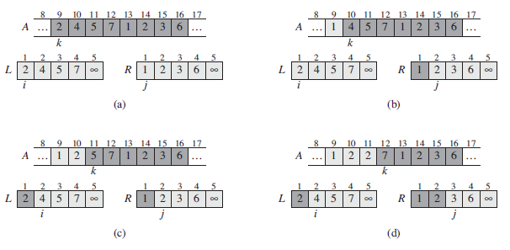

Slide 11
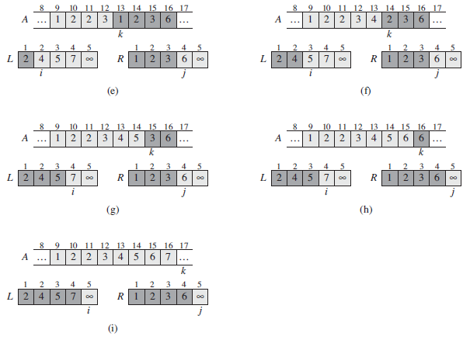

Slide 12
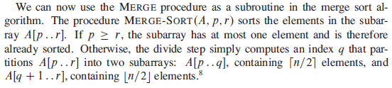
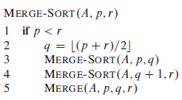
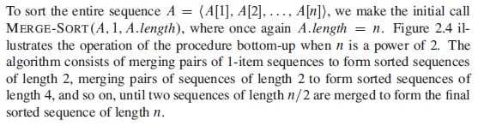

Slide 13
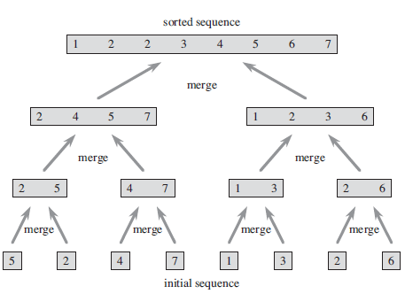

Slide 14
Analyzing divide-and-conquer algorithms
When an algorithm contains a recursive call to itself, we can often describe its running time by a recurrence equation or recurrence, which describes the overall running time on a problem of size n in terms of the running time on smaller inputs.
A recurrence for the running time of a divide-and-conquer algorithm falls out from the three steps of the basic paradigm. As before, we let T(n) be the running time on a problem of size n. If the problem size is small enough, say n c for some constant c, the straightforward solution takes constant time, which we write as ‚ O(1).

Slide 15

Analyzing divide-and-conquer algorithms
Suppose that our division of the problem yields a subproblems, each of which is 1/b the size of the original. (For merge sort, both a and b are 2, but we shall see many divide-and-conquer algorithms in which a ≠ b.)
It takes time T(n/b) to solve one subproblem of size n/b, and so it takes time aT(n/b) to solve a of them.
If we take D(n) time to divide the problem into subproblems and C(n) time to combine the solutions to the subproblems into the solution to the original problem, we get the recurrence

Slide 16
Analysis of merge sort
Although the pseudocode for MERGE-SORT works correctly when the number of elements is not even, our recurrence-based analysis is simpliﬁed if we assume that the original problem size is a power of 2. Each divide step then yields two subsequences of size exactly n/2.
We reason as follows to set up the recurrence for T(n), the worst-case running time of merge sort on n numbers. Merge sort on just one element takes constant time. When we have n>1elements, we break down the running time as follows.

Slide 17
Analysis of merge sort
Divide: The divide step just computes the middle of the subarray, which takes constant time. Thus, D(n/)= O(1).
Conquer: We recursively solve two subproblems, each of size n=2, which contributes 2T(n/2) to the running time.
Combine: We have already noted that the MERGE procedure on an n-element subarray takes time ‚O(n), and so C(n)= O(n).

Slide 18


Analysis of merge sort
When we add the functions D(n) and C(n) for the merge sort analysis, we are adding a function that is ‚O(n) and a function that is ‚O(1). This sum is a linear function of n, that is, O(n). Adding it to the 2T(n/2) term from the “conquer” step gives the recurrence for the worst-case running time T(n)of merge sort:
Let us rewrite above equation:

Slide 19
Merge sort: Running Time Summary
• Divide: Split array of size n into two subarrays of size n/2
• Conquer: Two recursive calls on subarrays of size n/2
• Combine: Merge two sorted subarrays to create sorted array of size n
Let T(n) = running time of merge sort on array of size n
T(n) = Tdivide(n) + Tconquer(n) + Tcombine(n)
T(n) = θ(1) + [T(n/2) + T(n/2)] + θ(n)
T(n) = 2 T(n/2) + θ(n)
• Number of recursive subproblems = 2
• Size of each subproblem = n/2
• Time for all the non-recursive steps = θ(n)
The solution for T(n) = 2 T(n/2) + θ(n) is
T(n) = θ(n lg n)

Slide 20
Thank you

